Slide 1
Highbrow Wines Case
Pietro rinaldi

Slide 2



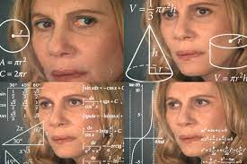


About me
Graduated in 2017 from the Bocconi / CEMS double degree
~2 years working in Paris for British American Tobacco
“There has to be a better way than Excel”
Upskilling in data science with Growth Tribe
2.5 years now in Brussels working for Unilever Food Solutions
&
X

Slide 3
Case – Problem Statement & Structure
Problem statement: Propensity scoring, rank customers by who’s likeliest to buy HBW
Structure of solution (iteratively):
EDA: understand what’s the data
Feature engineering: get the most of it
Modeling: feed it through a model & fine-tune it
Predicting: generate final predictions

Slide 4
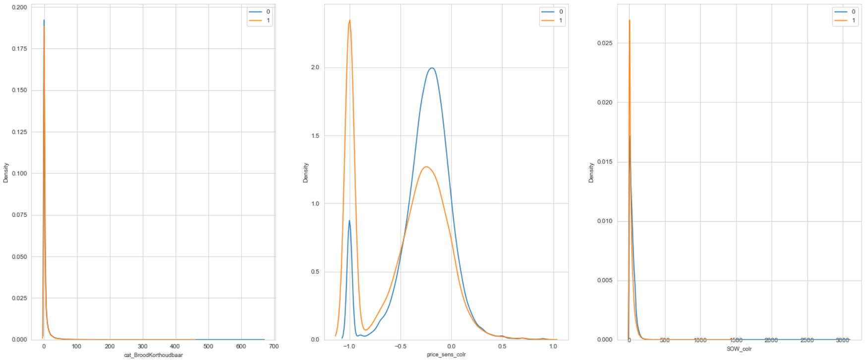
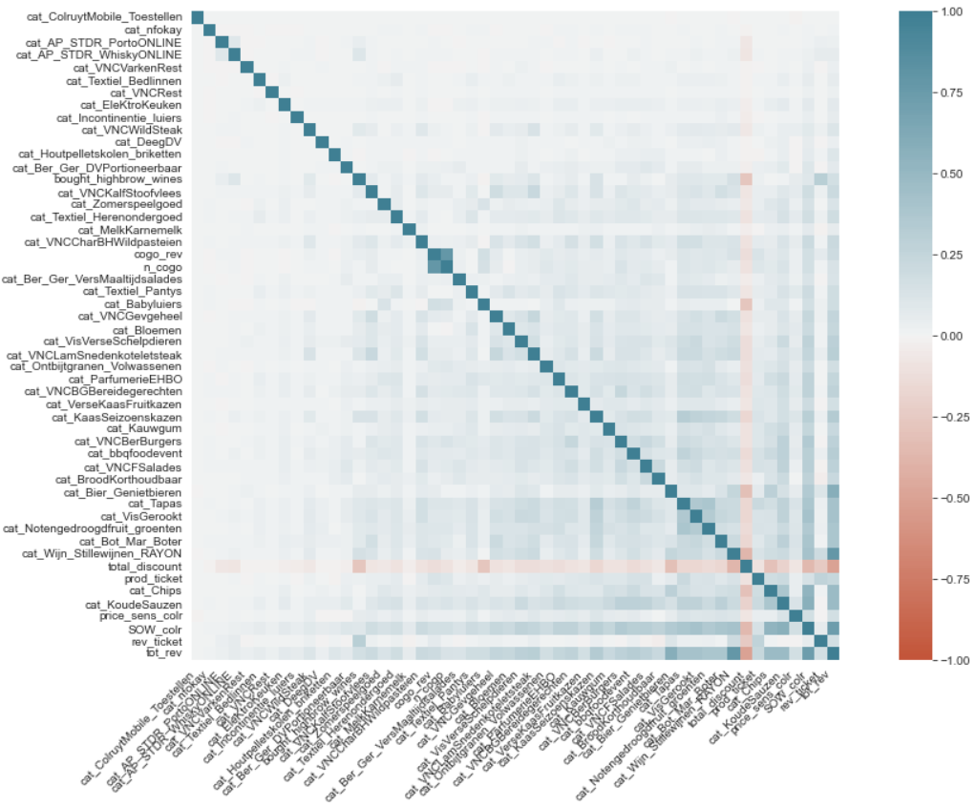
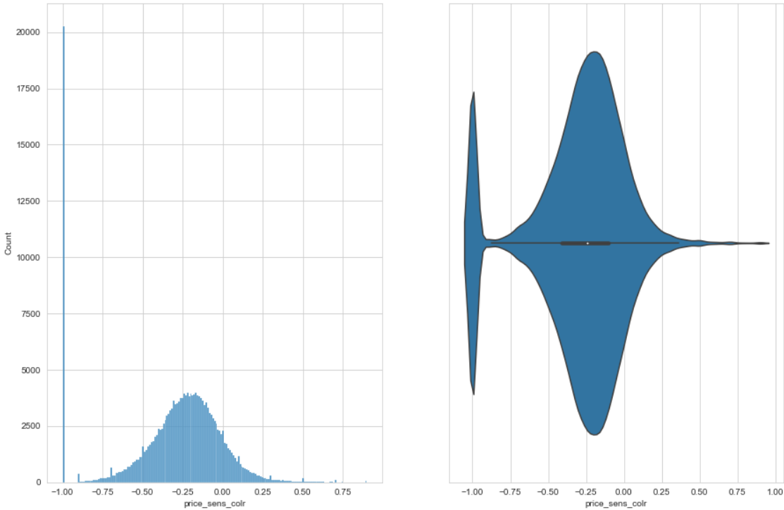
Case – EDA
Sample sizes & features: 200k rows, 55 total features. Each row is a unique customer
Outcome: missing values & outliers identified, found out “fishy” values
Example distribution, Target = 1 vs Target = 0
Correlation heatmap
Look for outliers

Slide 5
Case – Feature engineering
Build a baseline model to compare with, and see how much we can improve it by working on the data
Steps taken:
Removed some features because their values were odd (and there was no possibility of validating them with business users)
Created new features (“top_dem”, “apero”, cluster variables) to capture potentially interesting effects & “score”
Removed observations which also had odd values (e.g., share of wallet > 100)
Chose missing values approach (remove those in remaining columns, lacking a sensible input strategy)
Chose approach for remaining outliers (Winsorization)
Focus on precision

Slide 6
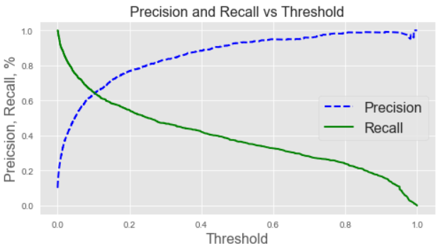
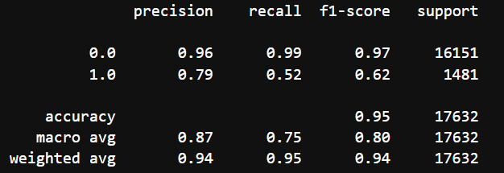
Case – Modeling
Test multiple models & tune hyperparameters
Tested models: logistic regression, XGBoost, LightGBM
LGBM best perfomer
Methodology: grid search (Optuna) with cross validation + further testing on holdout sample
Final metrics on holdout sample data: ROC AUC 93.6%
Confusion matrix for p > 0.23

Slide 7
Case – Limitations and next steps
Key limitations:
lack of domain knowledge to inform modeling / feature engineering steps
Cannot choose smartly the precision / recall threshold without user input (e.g., “few but precise”)
Next steps:
Check business success criteria and choose whether to focus on recall or precision
Optimize predictions accordingly
Further fine-tune the model / test other models if necessary to achieve better the business goals
Potentially, test adding a little bit more regularization
Split more intelligently the hold out set

Slide 8
Analytics opportunities in retail
Next best offer: propose related new products through recommender systems / market basket analysis
Next best action: use an NBA tool to suggest the next best touchpoint
Clustering along different variables (RFM, discount, product types…) to unlock insights about consumers
Time series analysis for forecasting sales, so that inventory management can be improved
Churn prediction for digital customers to nudge them when they are at high risk of churn
New product introductions: Look at which product categories have highest growth potential for white-label brands NPIs

Slide 9
Thank you & Q&A

